Slide 1
MBA 745: Doing Business Abroad Budapest, Hungary Prague, Czech Republic
March 11-18, 2017
Information Session

Slide 2
Preliminary Itinerary

Slide 3
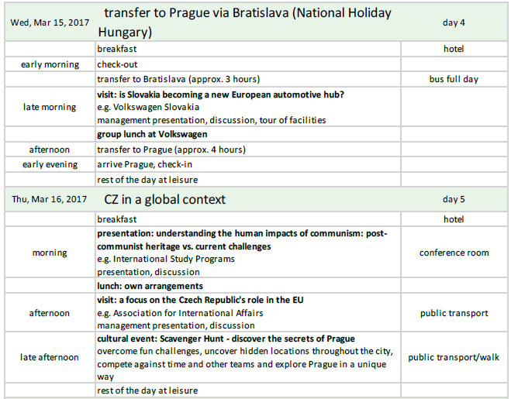
Preliminary Itinerary

Slide 4
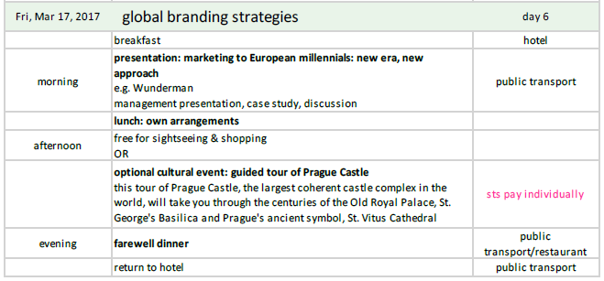
Preliminary Itinerary

Slide 5
Registration and Costs
Application: mba.uncg.edu/current-students/study-abroad
Registration: Students will be registered by November 22
Cost: $2700—Airfare not included (minimum 15 students) *UNCG and The Bryan School of Business and Economics reserve the right to cancel or alter the program format or to change costs in case of conditions beyond its control.*
Deposit: Acceptance of applications will run through September 27, 2016. Upon acceptance into the program a $500 deposit will be due by 5pm on October 14. **All deposits are non-refundable. Once final payment is made, there are no refunds.**
What’s included: Site tours Insurance
Ground transportation Tuition and fees
Corporate presentations Some meals
Accommodations (double occupancy)

Slide 6
Application and Payment Timeline
Application deadline: | September 27
Decisions made by: | October 4
$500 deposit due: | October 14, 5pm
Remainder due (part of final tuition bill): | December TBA
Pre-departure seminar: | January 20, 5:30 – 7:30pm

Slide 7
MBA 745: Doing Business Abroad Dr. Kwasi Amoako-Gyampah
Pre-Departure Seminar
Daily Journal
Final Paper

Slide 8
Q&A
mba.uncg.edu/current-students/study-abroad

