Slide 1
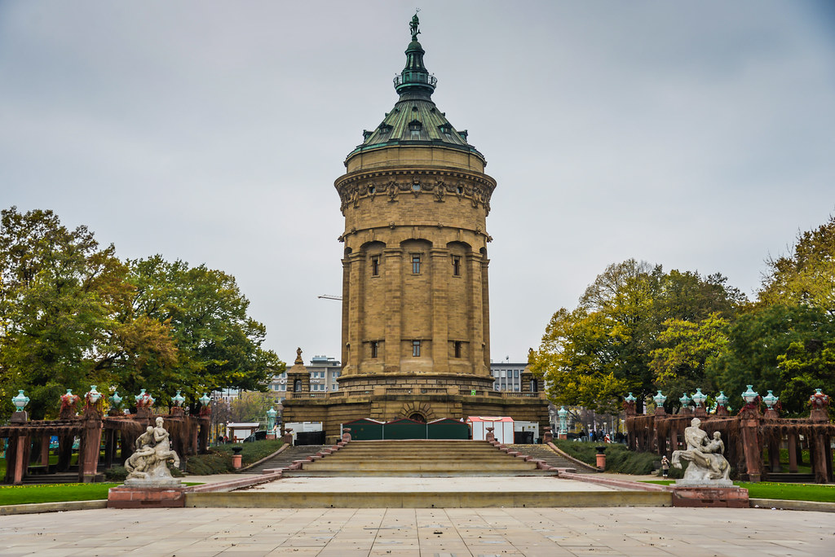
MBA 745:
Experience Business Abroad
Mannheim, Germany
March 1-7, 2020

Slide 2
Program Cost: $2500*
- All in-country activities (company & cultural site visits)
- In-Country Transportation
- Lunch vouchers
- Faculty (UNCG & Mannheim) and staff support
- International health insurance
Additional Expenses:
- Est. $500 for lodging (shared room in a hotel)**
- Est. $1200 for flight (check out Expedia or Skyscanner)
Total Estimated Cost: $4200
The Cost
*Financial aid may be able to be applied to this cost. Please speak to a financial aid advisor about your personal situation.
**The Mannheim team is working with the hotels to get discount codes for students to use when booking rooms. We will share these once we have 20 confirmed participants!

Slide 3
A week hosted by Germany’s #1 business school!
An international experience with access to large, multi-national companies that are based in Germany.
Guided cultural experiences and free time to explore on your own.
The Rewards

Slide 4
Lectures and academic studies led by experienced, researched, and well-recognized Mannheim Business School professors.
3 credit hours towards your degree. (Applicable towards electives or concentration, please check with your Academic Advisor.)
The Rewards

Slide 5
*Vouchers are provided daily for lunch and coffee breaks. These can be used at the University Café or at local restaurants.

Slide 6
Registration Timeline
To Do | Due Date
Start your MBA 745 Application | Today!
Ask questions to Sara, your academic advisor, and/or Dr. Acquaah. | Between now and 10/31 at 5pm
Finalize & submit MBA 745 Application | Thursday, October 31, 2019
Nonrefundable program deposit ($500) due to IPC. | Friday, November 15, 2019
Notification of attendance in the program | TBD – December 2019
Attend pre-departure meeting | TDB – Most likely January 2020

Slide 7
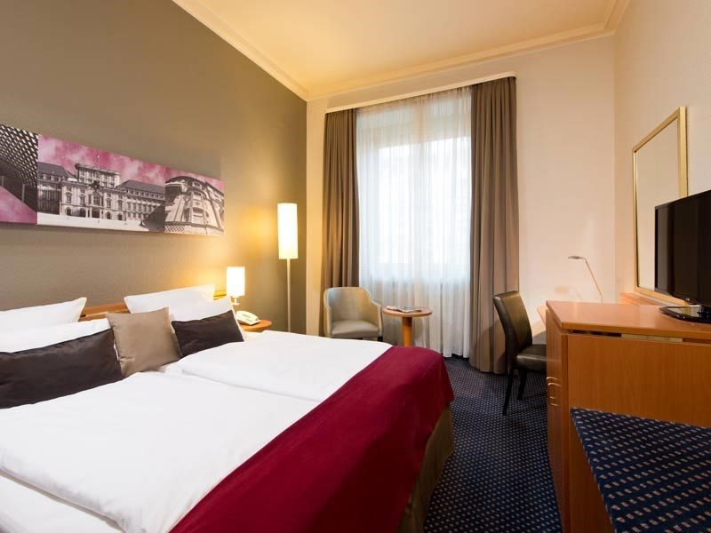
Single: Appr. 123 Euro per night
Double: Appr. 141 Euro per night
Includes Breakfast
*The Mannheim team is working with the hotels to get discount codes for students to use when booking rooms.

Slide 8
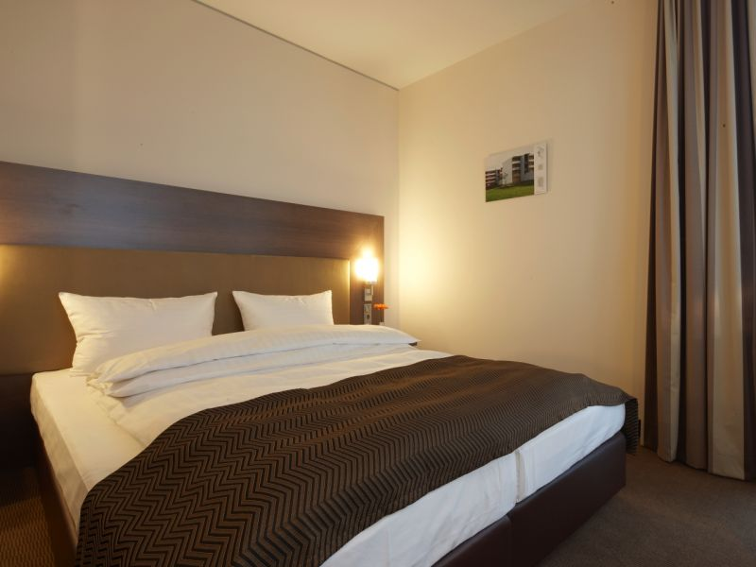
Single: Appr. 105 Euro per night
Double: Appr. 130 Euro per night
Includes Breakfast
*The Mannheim team is working with the hotels to get discount codes for students to use when booking rooms.

Slide 9
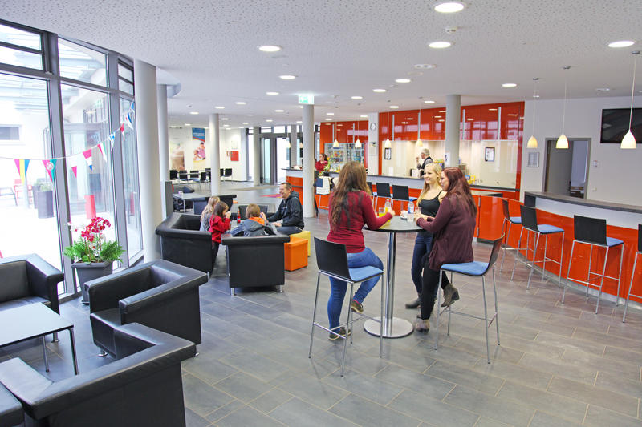

Slide 10
“Our classroom learnings were supplemented by carefully planned
company visits, which gave us a very good perspective on the technical advancement of Germany companies and the industrious nature of the German people. I will never forget the time spent at Mannheim – I never thought such a short program would have such an impact on me.”

Slide 11
“I enjoyed the chance to meet people from all over the world with diverse cultural, educational, and career backgrounds and made many valuable additions to my network.”

Slide 12
Mannheim, Germany
March 1-7, 2020
Apply here!
https://tinyurl.com/Mannheim2020
Once you are ready to make your program deposit to IPC,
go to the “Budget” tab on the Application page for details
on how to submit your deposit!

